Slide 1
Getting on Board with Icon
Discussion – 6 July 2021

Slide 2
Charity Governance Code
Principles
Diversity
Leadership
Integrity
Organisational purpose
Openness and account-ability
Decision-making
Board effective-ness
Charity Governance Code
Good governance is fundamental to a charity’s success. It enables and supports a charity’s compliance with the law and relevant regulations. It also promotes a culture in which everything works towards fulfilling the charity’s vision.
The Charity Governance Code is a practical tool to help charities and their trustees develop high standards of governance.
https://www.charitygovernancecode.org
Notes:
The charity environment has changed considerably since the first governance code for the sector was produced in 2005, with recent years being particularly challenging. The ramifications of fundraising practices and high-profile governance failures are still playing out in the media, and there is much to be done in the sector to shore up public confidence. The new Charity Governance Code was published in July 2017, and where previous versions of the code were criticised for being overly focused on processes and procedures, this version tries to find a balance between the mechanics – the policies, procedures and processes – and the dynamics – the people, behaviours and culture – of good governance.
The Code:
Is a set of seven principles
Is designed as a tool to help charities and their trustees develop high standards of governance and support continued improvement
Is not a legal or regulatory requirement (but comply or explain)
The Code can be accessed online at www.charitygovernancecode.org or downloaded into PDF documents. It is expected that the way charities use the Code will develop over time as a charity grows and changes. The auditors suggest that trustees discuss the Code’s principles in line with the values and aims of the charity, and encourage those that adopt the Code to publish a brief statement in their annual report to explain their use of the Code, adopting the “apply or explain” approach.
We are currently working through the Code – a report will be presented to the Board in March.

Slide 3
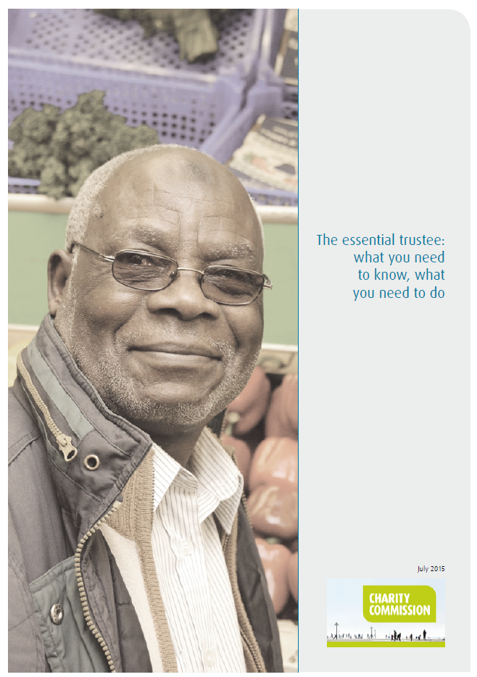
Role of trustees and the Board
Carry out charitable purposes for public benefit
Comply with the charity’s governing documents and the law (and policy)
Act in your charity’s best interests
Manage your charity’s resources responsibly: Duty of Prudence
Act with reasonable care and skill: Duty of Care
Ensure your charity is accountable
Charity Commission: CC3 – The Essential Trustee

Slide 4
Icon’s Charitable Objects
To advance the education of the public by research into and the promotion of the conservation of items and collections of items of cultural, aesthetic, historic and scientific value; and
To preserve and conserve items and collections of items of cultural, aesthetic, historic and scientific value.

Slide 5
Role of trustees and the Board
Carry out charitable purposes for public benefit
Comply with the charity’s governing documents and the law (and policy)
Act in your charity’s best interests
Manage your charity’s resources responsibly: Duty of Prudence
Act with reasonable care and skill: Duty of Care
Ensure your charity is accountable
Charity Commission: CC3 – The Essential Trustee

Slide 6
Role of trustees and the Board
Charities should be led by an effective Board that provides strategic leadership in line with the charity’s aims and values.
Trustees should be clear about the charity’s aims and the Board should ensure that these are being delivered effectively and sustainably.
Good governance is fundamental in the success of a charity and reflects the ever changing expectations from society.

Slide 7
Strategic Priorities for 2021/22
Advocacy – promoting the value of conservation; and championing the care of collections
Excellence – increasing the visibility, recognition and take-up of Icon accreditation; and leading action on environmental sustainability
Engagement – taking steps to support diversity and inclusion; and encouraging more people to join Icon as supporters
And:
Effective and sustainable – delivering steady membership growth; and rebuilding Icon’s reserves to ensure greater resilience
Also… developing and publishing the next Icon strategy (2030)

Slide 8
Role of trustees and the Board
Charities should be led by an effective Board that provides strategic leadership in line with the charity’s aims and values.
Trustees should be clear about the charity’s aims and the Board should ensure that these are being delivered effectively and sustainably.
Good governance is fundamental in the success of a charity and reflects the ever changing expectations from society.

