Slide 1
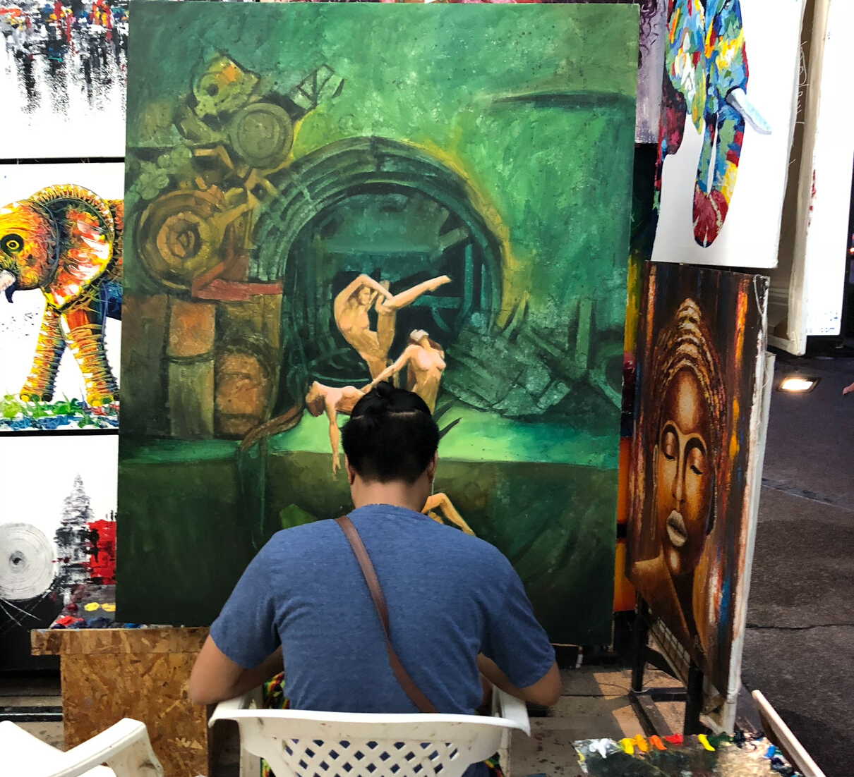
A great way to stay in touch!
Publications
Iconnect e-news
Event discounts
Group resources
Members-only chatroom
CPD support
icon.org.uk
Join today to network with conservators across the globe!

