Slide 1

About Us
an introduction to Icon
2020

Slide 2
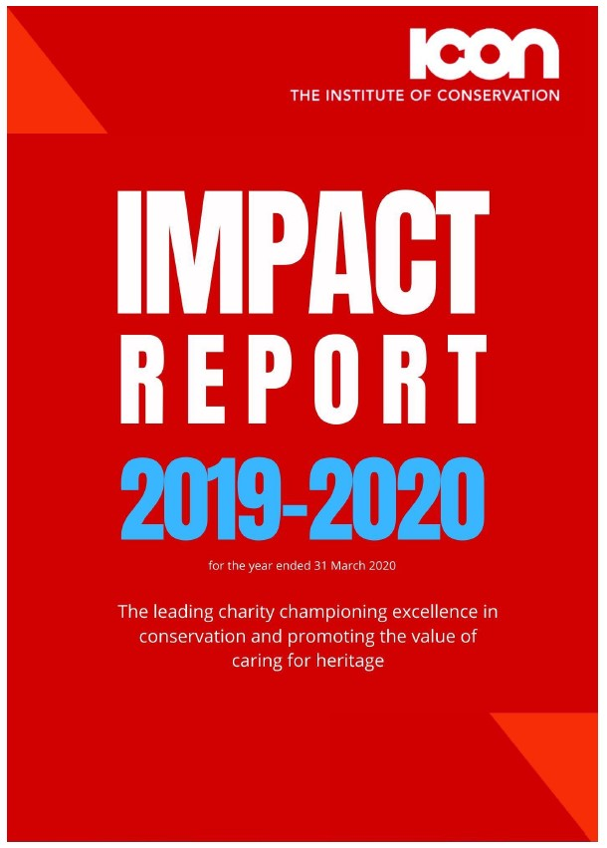

“The Institute of Conservation is a membership organisation and charity which brings together those with a passion for the care of cultural heritage. Icon raises awareness of the cultural, social and economic value of caring for heritage and champions high standards of conservation.”
Find out more about our impact:
www.icon.org.uk/about-us/icons-impact

Slide 3
Key Facts
An independent charity governed by a Board of Trustees.
A membership organisation representing nearly 2,500 individuals and organisations, including professional conservators, volunteers and owners of cultural heritage.
A professional body raising the standards of conservation practice through Accreditation, a Code of Conduct, Professional Standards and Complaints Procedure.
A small enterprise with 10 employees offering expertise in membership services, finance, professional development, communication, strategy, policy and advocacy.

Slide 4
History
Icon was founded in 2005 when 5 existing conservation bodies converged into one new organisation:
UK Institute for Conservation
Institute of Paper Conservation
Scottish Society for Conservation and Restoration
Photographic Materials Conservation Group
Care of Collections Forum

Slide 5



Our Strategy and Activities
Influencing our partners and the public
enhancing our visibility with government and policy makers – responding to consultations – undertaking fresh research – designing campaigns to engage partners and the public
ADVOCACY
Building knowledge, high standards and valuing the profession
accrediting professional conservators – developing our standards –
managing a highly regarded internship programme – delivering professional development programmes – running regular events – sharing publications
ENGAGEMENT
Encouraging public awareness and participation
tailoring membership offers – engaging with emerging professionals – collaborating with partners to diversify workforce – promoting benefits of conservation to society and wellbeing
EXCELLENCE

Slide 6






Our Members
2,548 members 772 Accredited Conservator-Restorers 475 volunteers
Working across:
16 Special Interest Groups
8 Networks
Archaeology
Care of collections
Furniture & wood
Heritage science
Photographic materials
Gilding & decorative surfaces
Ceramics & glass
Ethnography
Textiles
Metals
Book & paper
Historic interiors
Paintings
Scotland
Stained glass
Stone & wallpaintings
Modern materials
Documentation
Contemporary art
Emerging professionals
Dynamic objects
Higher education
Northern Ireland
Environmental sustainability
Public sector, e.g. in museums, archives and libraries
Private sector, with 1/3 self employed and over 50 % in microbusinesses (<10 employees)
Third and academic sector, e.g. trusts and university departments
Working across the UK with the majority in London and the South and 17.5% abroad

Slide 7
Our Membership Categories
Accredited
Associate
Student
Supporter
Assessed and reviewed by peers
Subject to CPD recall
ACR post-nominal
Professional conservators
May be working towards Accreditation
Enrolled on a course or undertaking entry-level internship
Passionate about conservation
Keen to engage with the sector
Notes:
Project need – Icon’s LMI out of date

Slide 8
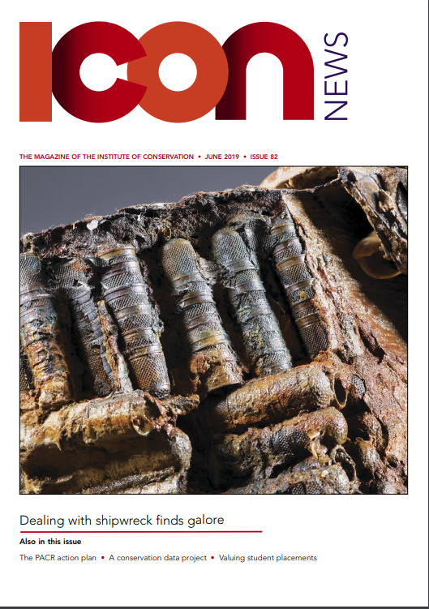
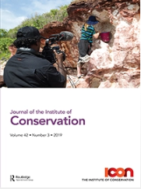
Our Publications
Icon News
Bi-monthly magazine featuring the latest conservation case studies, interviews, reviews, analysis and updates from staff.
Journal of the Institute of Conservation
Fully peer-reviewed publication presenting innovative research and practice-related articles on conservation. Published by Taylor & Francis three times a year.

Slide 9
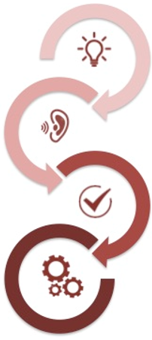
Our Advocacy – working to create positive change for the conservation profession
Advancing knowledge and understanding
Awareness
Framing policy debates and getting issues on the agenda
Attitude
Affecting language, rhetoric and endorsements
Rhetoric
Influencing actions and implementation of policy
Behaviour

Slide 10
Our Advocacy – how we promote conservation
Greater awareness
Favorable regulatory and funding environment
Members
Influence
Policy responses, meetings, briefings, letters, reports, factsheets, newsletters
Engagement
Stakeholder maps, working groups, collective papers, partnerships, collaborations
Research
Policy Advisory Panel, research reports, case studies, newsletters, news stories
Cultural heritage is valued and accessible and its future is enhanced and safeguarded by excellence in conservation.
Greater engagement
Funding
Widespread understanding and appreciation
Greater advocacy
Staff
High quality of practice
Greater support
Inputs
Activities
Outputs
Outcomes
Impact
Vision

Slide 11
Celebrating Our Successes
Over the years, over 180 emerging conservators have kickstarted their careers in conservation through an Icon Internship.
Offers an invaluable opportunity for interns to develop their careers, engage with professional networks and develop practical knowledge.
Lets hosts focus on what they do best: to provide the experience and skills required for success in the workplace.
Introduces a strong understanding of the practical application of Icon’s Professional Standards in conservation.
Each intern assigned a dedicated Advisor, who along with the host supports them through the practicalities of the programme and with their professional development.
Since 2017 Icon has played a leading role in the development of Apprenticeship Standards for the profession.
The launch of the government’s Trailblazer Apprenticeships presented an opportunity to formalise vocational entry routes into conservation.
Icon convened and supported a representative employer group to design programmes that matched real job roles and skills requirements.
In 2019, the Institute of Apprenticeships approved the Cultural Heritage Conservation Technician and Conservator Apprenticeships.
The programmes have the potential to enhance sector diversity by making entry routes more accessible.
We will work closely with Universities and Colleges in the delivery of the new programmes.

Slide 12
Looking Ahead
In 2020, we will relaunch the Conservation Register as a new and improved public-facing resource for finding Accredited Conservator-Restorers.
Owned and operated by Icon since 2005 as the key directory for people who need advice and support to care for their objects and collections.
New Register to feature an up-to-date list of all Icon Accredited Conservator-Restorers.
The public will be able to easily identify and contact an accredited professional to ensure a safe future for their family heirlooms and the things they love.
2020 will be a busy year of celebration events to mark 20 years since the introduction of Icon Accreditation.
Launch of a new logo and post-nominal for our Accredited Conservator-Restorers.
Publication of Icon’s Professional Standards, currently being revised following consultation.
CPD programme to support members in developing their careers
Dedicated party to help us celebrate in style!

Slide 13
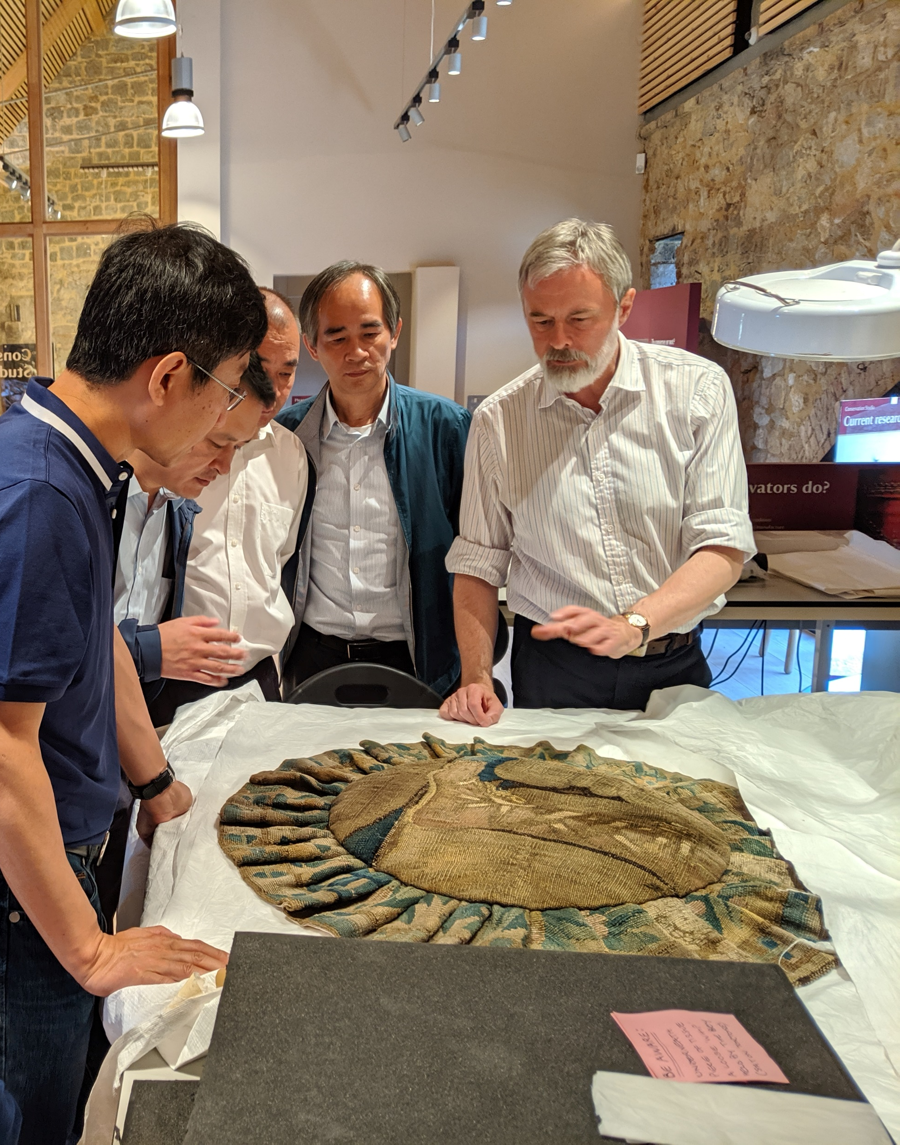
Find out more…
www.icon.org.uk
Join the conversation…
LinkedIn: www.linkedin.com/company/the-institute-of-conservation
Facebook: hwww.facebook.com/ConservatorsUK
Twitter: twitter.com/Conservators_uk

