Slide 1
ICON ARCHAEOLOGY GROUP
2021 AGM

Slide 2
First Aid for Finds
Sarah Watkins-Kenney

Slide 3
FIRST AID FOR FINDS 4th Edition
Joint publication: ICON and RESCUE
Authors: Sarah Watkins-Kenney, David Watkinson, Jim Spriggs, Nicola Emmerson
Lead author: Sarah Watkins-Kenney
Draft Section to Focus Group Reviewers (Nov-Dec 2020).
Content and organisation of 4th Edition.
Draft 1 All Text and co-authors completed review (end July 2021).
MOU drafted and agreed (Spring 2021)

Slide 4
FIRST AID FOR FINDS 4th Edition
A practical field-manual primarily for non-conservators working with freshly excavated archaeological finds.
A reference for all involved with finds, including professional conservators, students, archaeologists, and finds staff generally.
Organised in three parts following steps in archaeological process
Part I: Planning and Preparation
Part II: On site
Part III: Post excavation

Slide 5
FIRST AID FOR FINDS 4th Edition
Introduction
Part I | Planning and Preparation | Guidelines for Site Directors/Project Managers, Decay of materials
Part II | On Site | General Principles: labelling, marking, lifting, packing and storage; First Aid for finds by material types
Part III | Post Excavation | General Principles: storage, signs of decay, examination, analysis, processing finds, preparation for transfer to archive
Sources for Further Information
Appendices
Illustrations

Slide 6
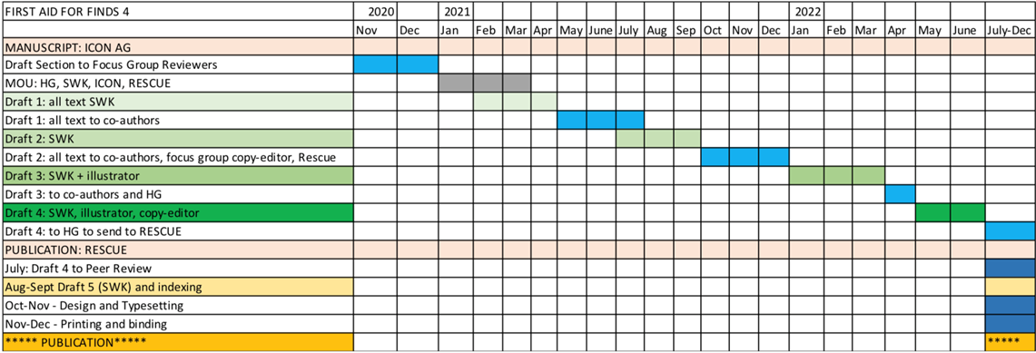

Slide 8
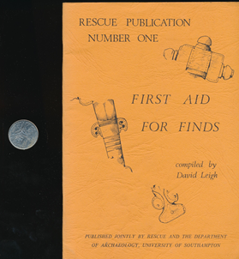
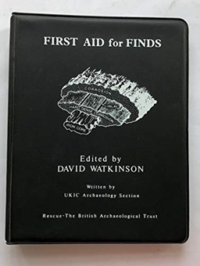
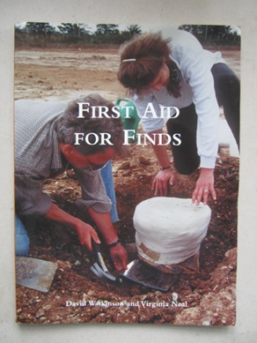
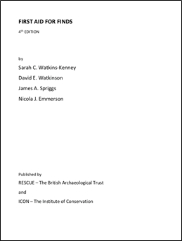
1972
1987
1998
2022
Published by Rescue: The British Archaeological Trust

