Slide 1




Passive is Sustainable
An exploration of passive storage environment vs. HVAC controls
Chris Woods
Director NCS
Our Business Members & Partners:
Conservation Resources UK
We are a registered Not-For-Profit Membership Body for Archives, Libraries & Museums

Slide 2
How to define ‘Sustainable Storage’?
• Not reliant on constant attention – conditions change slowly
• Suitable climate achieved by building structure itself
• Does not require energy to maintain internal conditions
• Can be left unattended without risk of internal climate deteriorating
• Constructed with long-lasting materials (ideally with low or no carbon emissions)

Slide 3

Current BS/EN standards for storage
BS EN 16893:2018
Specifications for location, construction and modification of buildings or rooms intended for the storage or use of heritage collections
Promotes passive climate storage
Replaces PAS 198 and most of BS 5454
BS 4971:2017
Conservation & Care of Archive & Library Collections
Promotes passive approach
Replaces environment and packaging elements of BS/PD 5454

Slide 4
History - BS5454
BS5454:1989 essentially required air handling systems:
Clause 4.6 “ The repository should be designed to provide for accurate and constant control of its internal environment. It should be of thermally insulated construction and designed to accommodate the air-distribution ductwork connected to the air-conditioning plant, which should be situated outside the repository. ”

Slide 5
Fears of ‘stagnant air’
Both 5454:1989 and 5454:2000 were strong on needing air movement and forms of ventilation to remove ‘off-gassing’ of archives e.g.:
“ Air movement removes off-gassing of organic materials ”
This is followed by:
“ If a mechanical ventilation system is provided, it should be designed to reduce pollutant concentration by introducing a proportion of fresh air ”

Slide 6
Air Movement + Fresh Air
• Air movement was deemed the only way of preventing mould growth, with fresh air based on office and domestic building regulations:
• 1989 clause 7.4.3 “The air within the repository should be kept in continuous motion day and night, being recirculated to all parts of the repository six times an hour, with a 10 % intake of fresh air.” BR
• 2000 the amount circulated should be based on the cooling load required but fresh air should “not be less than 5 % to 10 %”

Slide 7
Ventilation – M&E engineer’s myth
• The myth: “Building Regulations require fresh air ventilation”
• The truth: Ventilation: Approved Document F (England & Wales)
https://www.gov.uk/government/publications/ventilation-approved-document-f
“ Requirement F1 does not apply to a building or space within
a building:
a. into which people do not normally go; or
b. which is used solely for storage; ”
Scottish Building Regulations
https://www.gov.scot/publications/building-standards-technical-handbook-2020-non-domestic/3-environment/3-14-ventilation/
“ There is no need to ventilate:
a. a store room used only for storage that requires a controlled temperature”

Slide 8
BS5454 v BS4971:2017
Environmental parameters:
• 5454 – fixed control point, plus/minus 5% & 1C, between 45% & 60% and 16C & 19C
• 5454 – cooled storage (above zero), for all photos and other media
• 4971 – annual average <18degC, not more than 23degC cautionary max, 13degC min as recommendation only; not above 60% and not below 35%
• 4971 – no more cooled storage, just freezing for acetated plastics etc., microclimate packages for RH sensitive materials e.g. magnetic polyester media

Slide 9
Fixed point temp vs. Annual average
For temperature, an annual average at a fairly low to moderate level can have a better long term outcome than trying to fix a temperature level using HVAC systems, only to have them fail and result in unseasonal or forced extremes. For example:
• If a material can comfortably accommodate an annual range of 13-23 ˚C, with an annual average of say 17 ˚C it may be considered better than running HVAC systems at 17 ˚C ± 1 ˚C, given their propensity to fail and the annual energy and maintenance costs and carbon emissions of seeking to maintain a fixed point.
• Can we reliably say that the thermodynamic benefits e.g. of the temp dropping to 13 ˚C in winter comfortably off-set the higher summer temperature of up to 23 ˚C and result in as least as good a preservative environment as a continuous 17 ˚C? Can anyone reliably measure the difference in longevity of 1 ˚C? Even if they could, would it be worth it?

Slide 10
HVAC review
• Fresh air – responding to the outside air and not specifically to the inside air
• Obsession with ‘off-gassing archives’ diverted design away from back-up use only concept and away from total recirculation
• Temperature-led systems designed for office, no dehumidification capacity or switching off cooling when the desired temperature reached even though dehumidification is still needed

Slide 11
HVAC risks
• Constant running fans, even when conditions within range – high energy use and constant wear for nothing
• BMS systems led by sensors commonly at the AHU, not inside the room – responding or not responding to the wrong room conditions
• Monitoring the air and not the moisture within boxed materials – e.g. failure to recognise that RH goes up in a box when temperature rises
• Fans continue to run when parts fail – e.g. high RH when summer dehumidification cooling or desiccant element fails, excessively low RH when winter humidification fails

Slide 12
HVAC design
• Modeling of RH conditions using thermal model software does not work for RH but is still used by design engineers to justify HVAC – another engineer’s scam
• HVAC RH control commonly relies on condensing excess moisture by dropping the air temperature suddenly by passing the air over cooled pipework, followed by reheating the air to the room temperature needed
• High moisture content summertime external air requires very low temperature cooling to remove sufficient moisture – frequently insufficient chiller capacity, especially chilled water cooling (switch to recirc only)

Slide 13
HVAC failure
• Assuming an HVAC air handling unit (AHU) with all its many operating parts will run continuously without fault or failure for a generation or more is like assuming a new car will run as new forever without any parts failing, any breakages, any wear-induced reduction in efficiencies etc. The energy, maintenance and carbon costs are huge and the system will need to be replaced every 20 years or so
• High moisture content summertime external air requires very low temperature cooling to remove sufficient moisture by condensing it over cooled pipes – frequently insufficient chiller capacity, especially chilled water cooling (switch to recirc only)

Slide 14
HVAC failure
• Experience over 35 years suggests that the majority of widespread mould outbreaks in archives stores have been caused by failure of HVAC systems resulting in high RH air being driven 24/7 through the collections
• The damage caused to whole collections by the failure of badly designed and/or failing HVAC systems undermines all the smaller preventive and remedial conservation actions carried out by conservators on objects
• Although figures are not widely available yet, those recorded suggest that more than half of a collecting institution’s operational carbon emissions are generated by running HVAC systems for storage

Slide 15
EN 16893 & Passive Principles
• Thermal stability – inside not significantly influenced by outside, very good insulation
• Air tightness (defined as test parameter in 16893)
• Water tightness, dry buildings and dry collections
• Monitoring the moisture content of the collections
• E.g. using earth contact and uninsulated floor slabs to provide natural cooling in summer and a minimum threshold in winter
We are a registered Not-For-Profit Membership Body for Archives, Libraries & Museums

Slide 16
Features to Remember
• A water-tight space with low air exchange and insulated against rapid temperature gain or loss results in RH stability, particularly inside packages
• An air-tight room that is also water-tight and contains a large volume of mostly hygroscopic materials results in an RH that is dominated by the moisture content of the collection, if no other undesired influences
• A humidity (RH) sensor will rapidly detect changes in ‘free’ air but those changes are not necessarily experienced by packaged objects
• Principles apply to a box and to a room

Slide 17
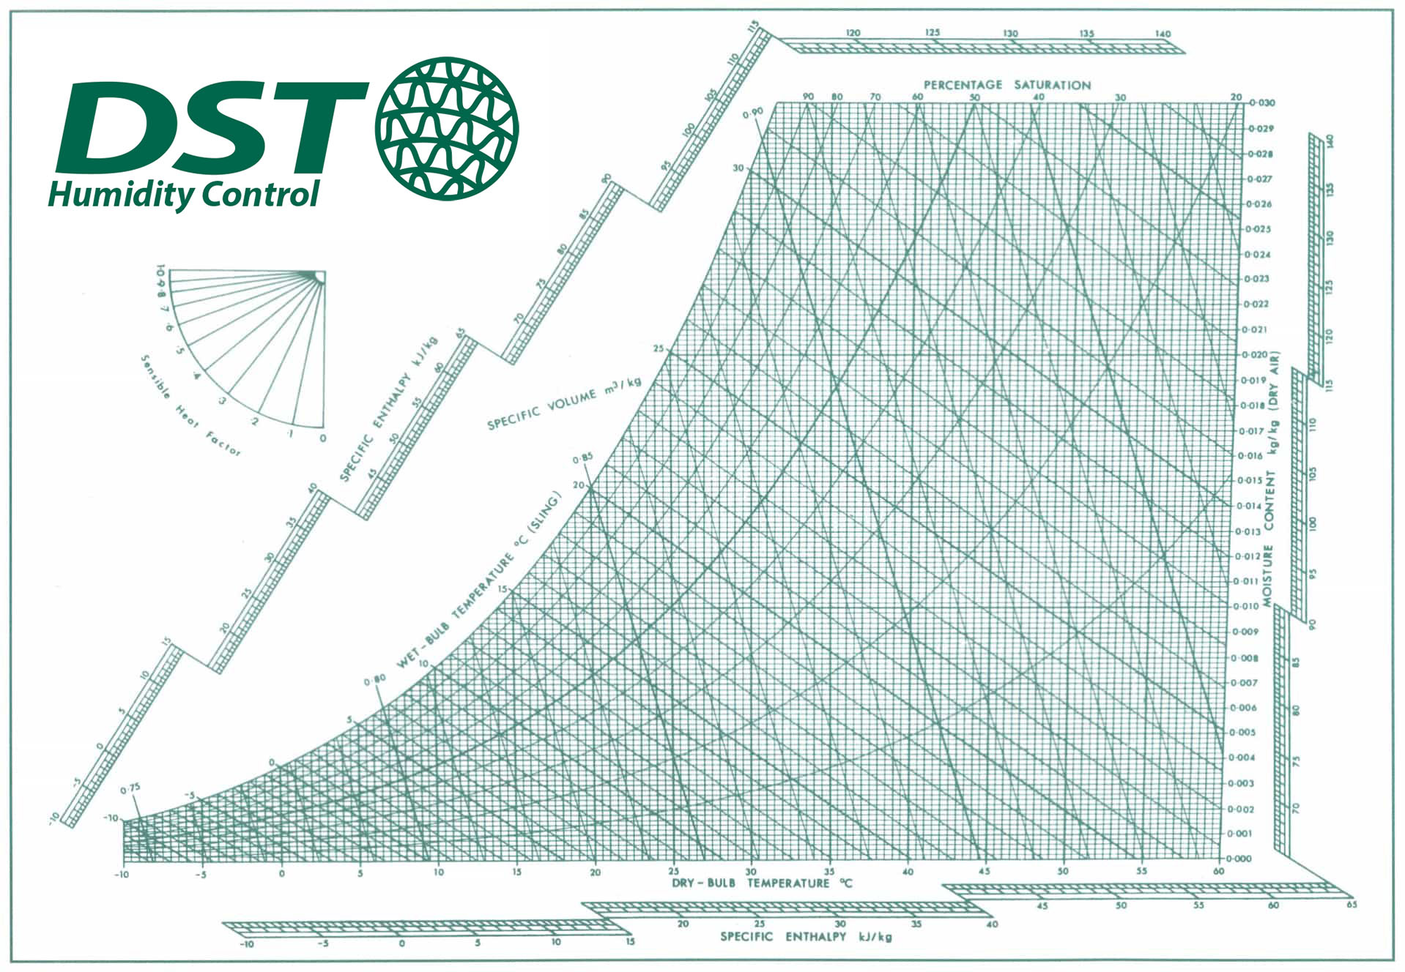
Significance of Air Tightness

Slide 18
1m³ dry air at 15°C weighs 1.225Kg. Add water to dry air so it measures 50% RH = 5.4millilitres per m³ (0.0054kg) – one teaspoon
Take a room 10mx20mx3m = 600m³ On mobile racking, allowing for aisles etc, the collections (8640 boxes on 1440 shelves) take up 54% of this space i.e. 325m³, leaving 275m³ free air
At 15°C and 50% RH the amount of water in the air in the room is 275 x 0.0054kg = 1.485kg - One and a half litres
At average 7kilos per box, the weight of the collection is 60,480kg – over 60 tonnes of paper, parchment, leather etc, holding approx. 6,000kg water @ 10% by weight

Slide 19
If the RH of all the free air in the room increases from 50% to 70%, the difference in the amount of air-borne water increases by 0.58kg to just over 2 litres of airborne water

Slide 20
Imagine a half a litre water soaked up across 60 tonnes of archives – would they get wet?
If the collection of 60 tonnes has 10% m.c. (6000Kg) at 15˚C and causes an air RH equilibrium of 50%, assuming it increases proportionally it will need to absorb two fifths of its water content to produce a 70% RH equilibrium (2400Kg or 2400 Litres)

Slide 21
At e.g. 1 room air change per DAY with 70% RH air, how long would it take for the archives to soak up enough water to reach equilibrium?
At 2 litres of airborne water per day it would take 1200 days – over 3 years – to absorb enough water (2400 litres) to create an equilibrium at 70% RH

Slide 22
Following the old 5454, at 6 room air changes per HOUR (one every 10 minutes) at 70% RH how long would it take for the archives to soak up enough water to reach equilibrium?
At 2 litres every 10 minutes, 288 litres per day, sufficient water input in 8.33 days, just over a week

Slide 23
What happens when we switch off the HVAC?
The rate of change of the internal environment will depend on:
• Air-tightness of the room
• Whether or not there is water penetrating into the room, e.g. rising damp
• What the moisture content of the collection is and its proportion of the space in the room (what RH was it when we switched off?)
• What time of the year we switched off

Slide 24
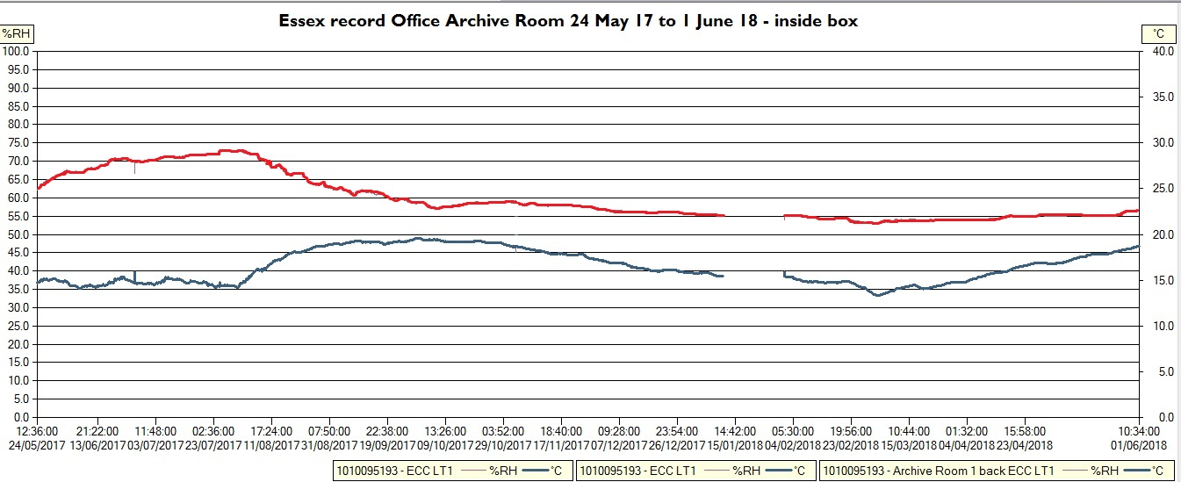
Example – On to Off

Slide 25
Can our store be suitable without HVAC?
Only by switching off HVAC systems and heating can we see how the building alone performs and whether it provides a stable environment. We are looking for:
• A slow rate of change in temperature, less than 1˚C in 24 hours;
• RH only changing when the temperature changes – fluctuating RH and independently of the direction of temp change means rapid air infiltration and/or penetrating moisture
• RH tracking in the same direction as the temperature, ideally at less than 2.5% change for every 1 ˚C
• Any RH consistent direction and level of change inside a package is some days behind change in the room
• RH inside packages changing very slowly, plenty of warning of high or very low RH, plenty of time to monitor and respond

Slide 26
Can our store be suitable without HVAC?
Some stores prove to be ideal and can maintain stable conditions all year around, others may need dehumidification or even cooling at key times of the year. Structural should be done first:
• Fix water leaks and damp rather than run HVAC 24/7 to dry problem walls and floors;
• Apply e.g. Blowerproof paint to walls, ceilings etc to reduce air infiltration through porous structures (see e.g. IWM Duxford)
• Replace non-compliant doors and surrounds with those that seal on all four edges when closed (including threshold)
• Add sealing caps to inert gas suppression pressure vents, to smoke extract fans and to old ductwork (do cling-film test)

Slide 27
Can our store be suitable without HVAC?
If a store only needs dehumidification from time to time and the cause cannot be remedied, scale down from the old 5454-style HVAC e.g.:
• Use smaller, independent desiccant dehumidification instead of relying on cooling systems, running on recirculated air only
• Only switch dehumidification on when RH is consistently high inside packages. ‘Dry’ out the collections then switch off (so run till RH inside boxes reaches a safe low level)
• Reduce air flow size of any back-up dehumidification – the rate of change can be slow as long as it is pulling down the RH
• Use RH microclimate packages for very sensitive objects – don’t specify HVAC RH control if most of your collection doesn’t need it

Slide 28
Questions?
www.ncs.org.uk

